Slide 1
Student’s Name: Vincent Mokaya: SVNT/2308/06 Institution Affiliation: SEVENNET BOOT CAMP Course Name: DATA ANALYTICS Instructor’s Name: Mr. Raghuvendra Anshu Date: 9/22/23
FINAL EXCEL PROJECT-MOVIE_DATASET.
10 INSIGHTS.

Slide 2
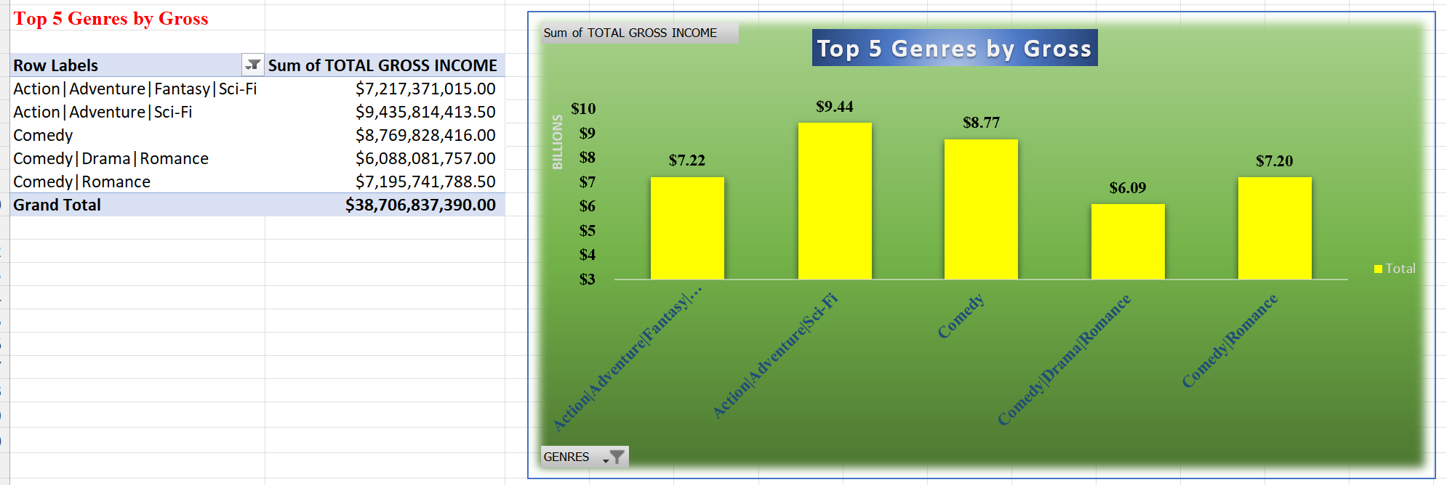
Top 5 genres by gross revenue can provide valuable insights like, Profitable Genres, Audience Preferences, Content Strategy, Show Market Trends, Better Budget Allocation.

Slide 3
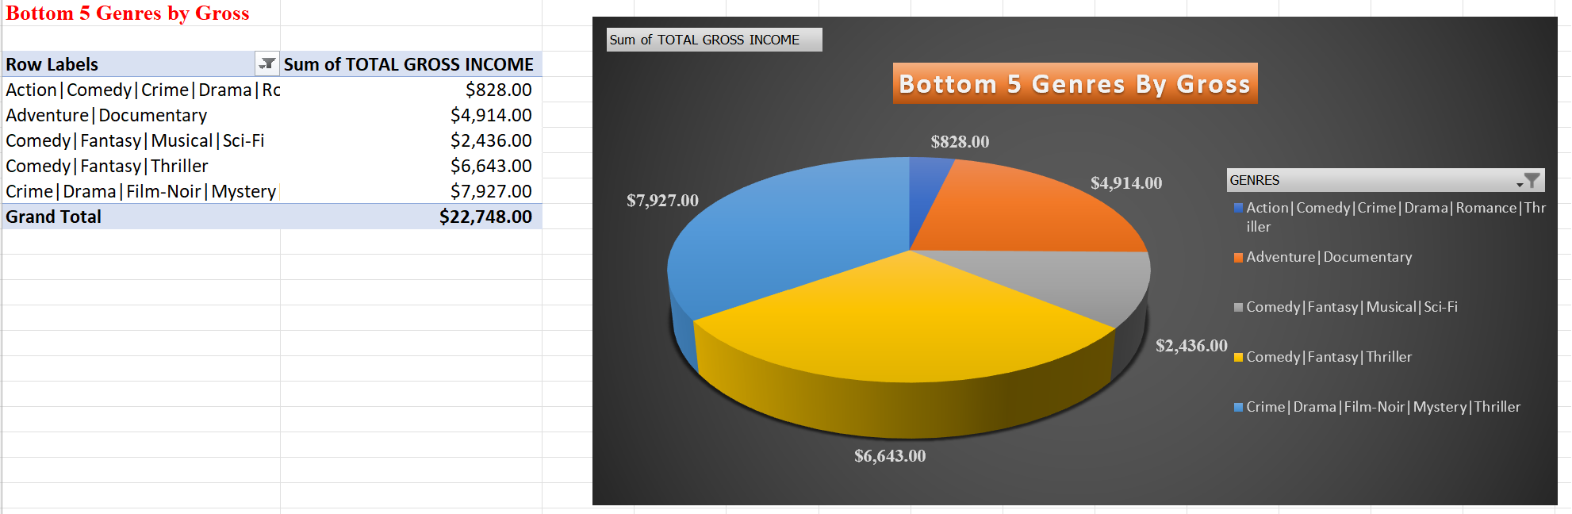
Bottom 5 genres by gross revenue can also provide valuable insights like, non- Profitable Genres, Audience Preferences, poor Content Strategy, Show bad Market Trends, Budget Allocation and if need to drop them and invest in most profitable or trending genres.

Slide 4
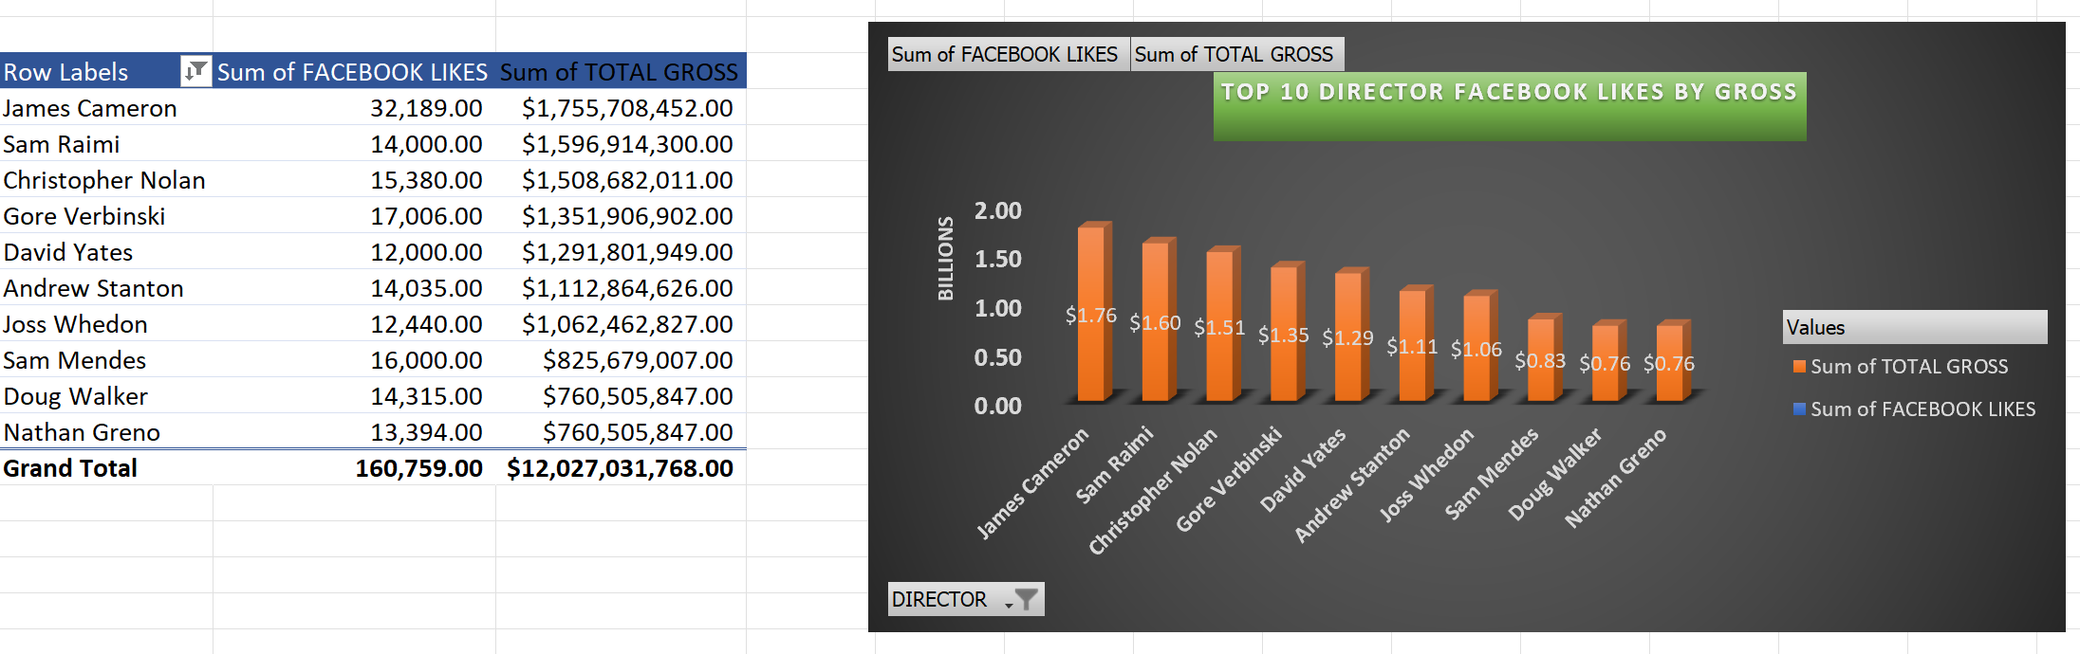
Analyzing the top 10 directors with the most likes on Facebook compared to the gross revenue of their movies can provide your client with insights into the influence of directors on the commercial success of movies. This Insight can indicate director popularity, audience engagement, director selection and marketing strategies.

Slide 5
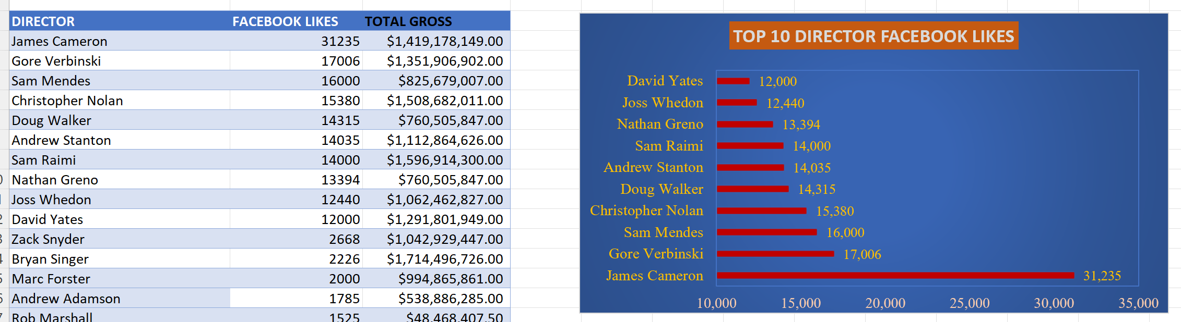
Directors with most Facebook likes can help a client determine the following, ROI assessment should a director with most likes be selected, Audience engagements, marketing strategies that can be adopted to market future movies, others are director popularity and targeted promotions.

Slide 6
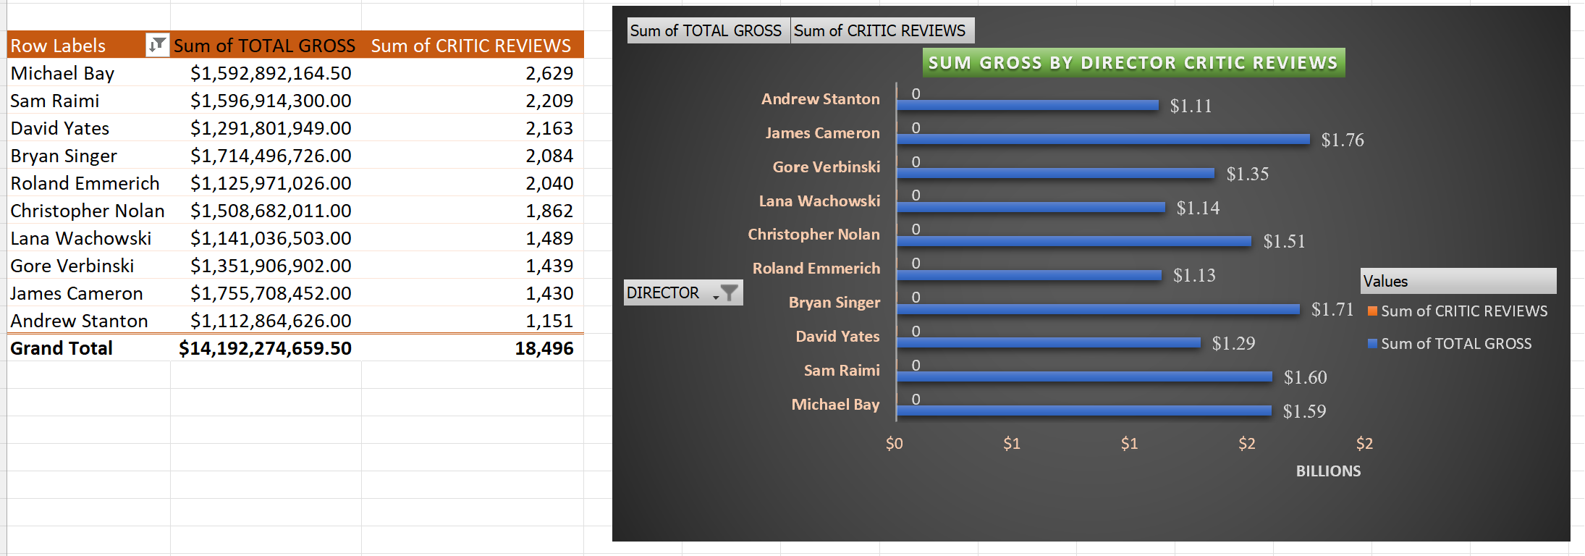
Analyzing the relationship between a director's critical reviews and the gross revenue of their movies can provide valuable insights into the impact of critical acclaim on commercial success in the movie industry. This valuable insight can indicate critical acclaim especially those directors with consistent positive reviews leading to appeal for their movies, others are directional reputation, awards recognition, and marketing strategies.

Slide 7
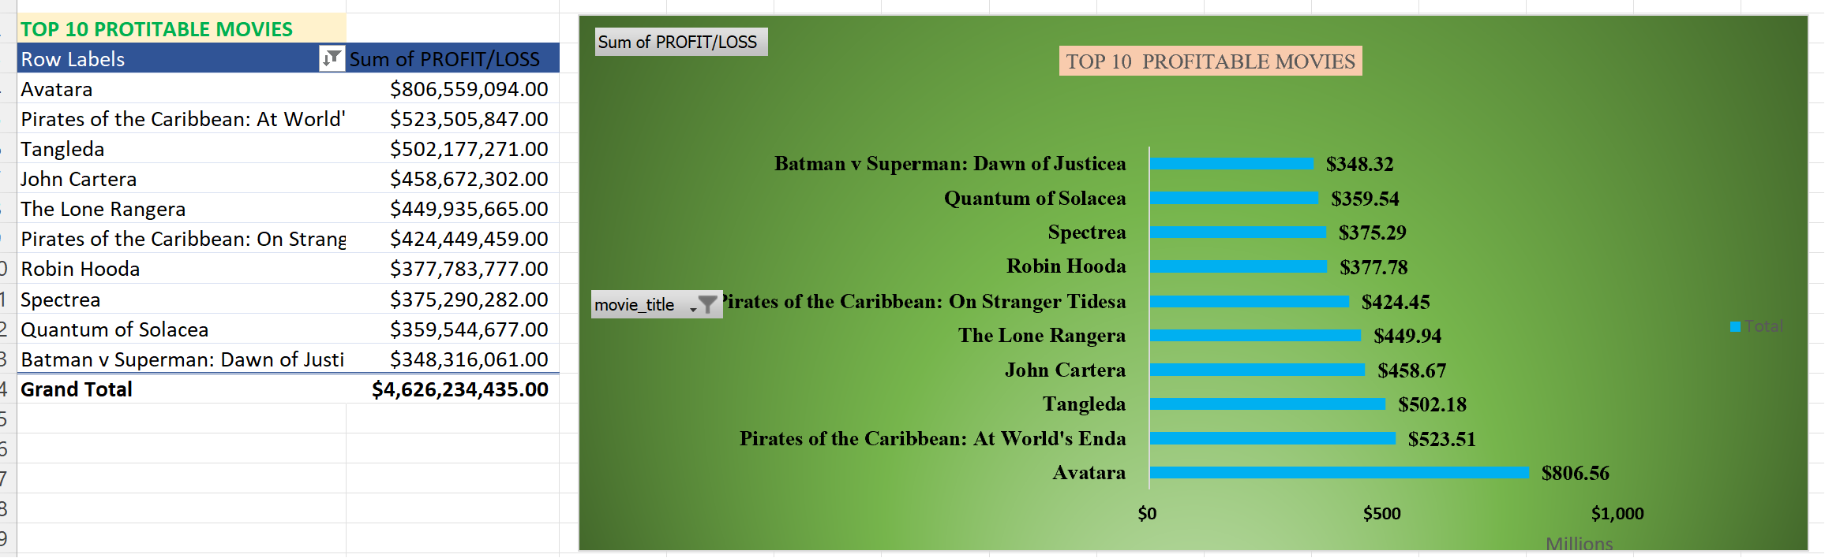
This insight will help provide valuable information on ROI and success of movies, genre insights, marketing efficiency, budget efficiency and successful nomination for awards and recognition.

Slide 8
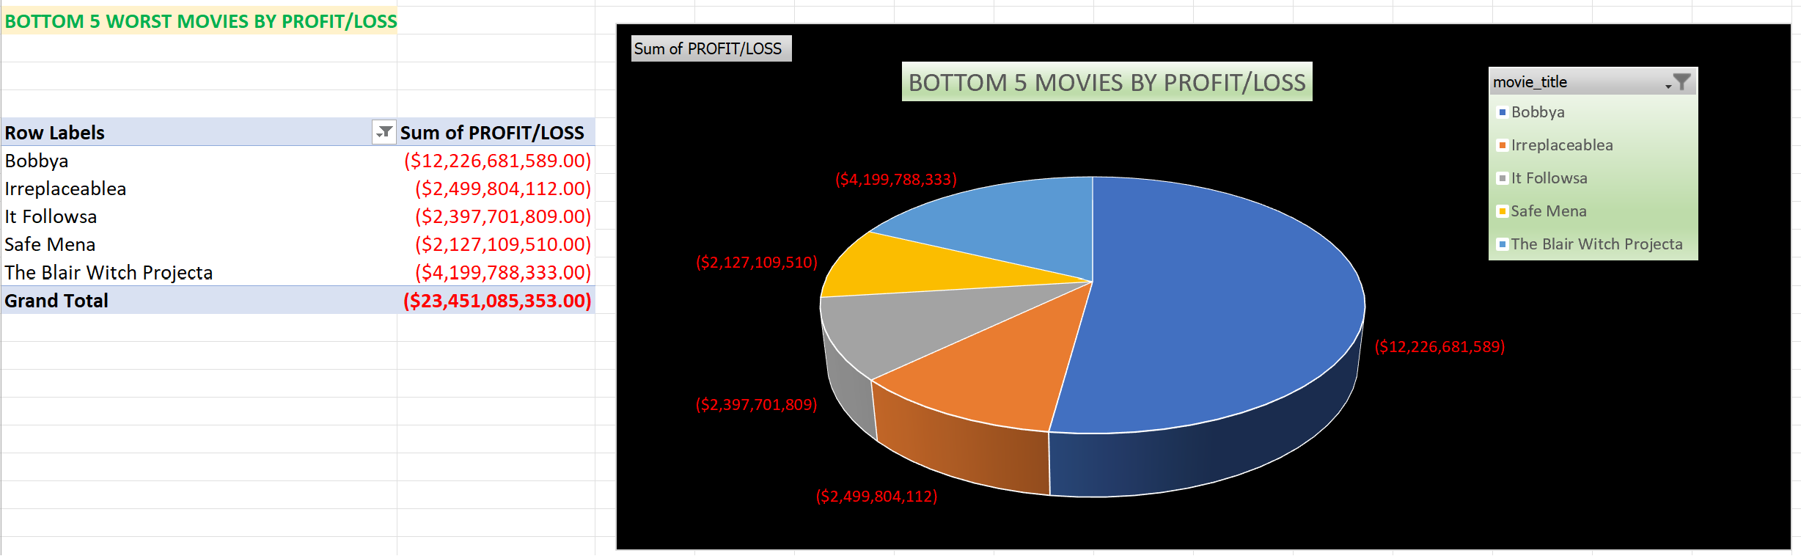
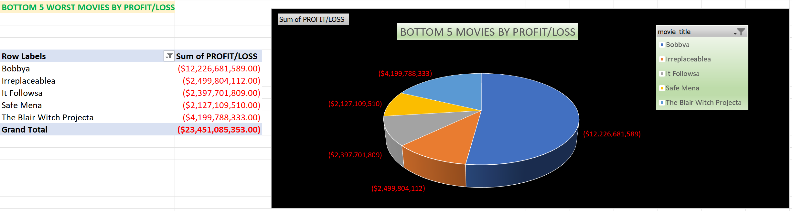
Poorly preforming movies all provide valuable information for future action, they help I identify need for more resources, bottle necks in marketing , poor trends, lowly rated directors and bad audience targeting. And if need be, shifting resources to better preforming movie genres.

Slide 9
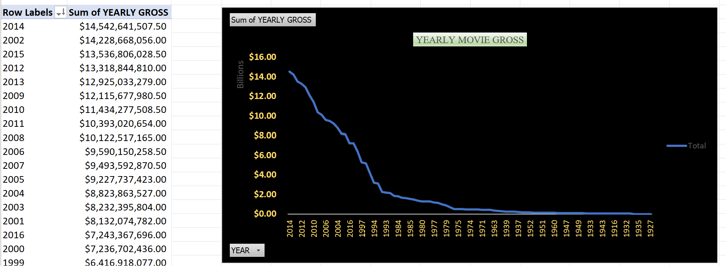
This insight helps in tracking yearly movie production trends that can help identify market saturation or gaps in the movie industry. It can inform decisions about when to release movies to avoid competition.

Slide 10
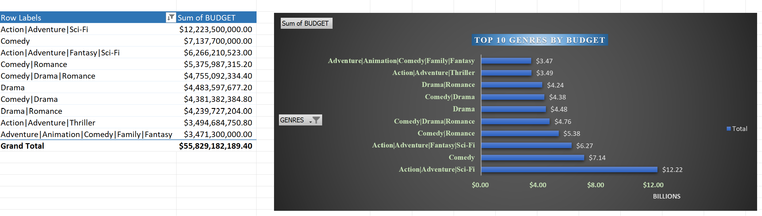
This insight provide information that can be used to assess budget allocations as some genres require a high budget, it also indicates , cost effectiveness in production, profitability considerations, risk assessments as they can be ambitious with some financial risk at times and lastly help indicate the production scale as shooting may be in many different locations.

Slide 11
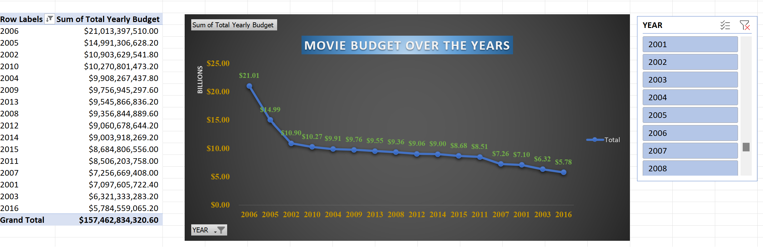
Budget trends over the years can provide your insights into how the film/movie industry's budgeting strategies have evolved. The key picks from this insight will be budget growth-this can help identify production trends if the budget has been increasing or decreasing. Others are economic factors, this can be depicted in budget trends e.g., recession, global calamities, and economic booms. Effects of technology can also be factors to investigate when assessing yearly budget allocations and genre specific trends to guide content strategy.

